Slide 1
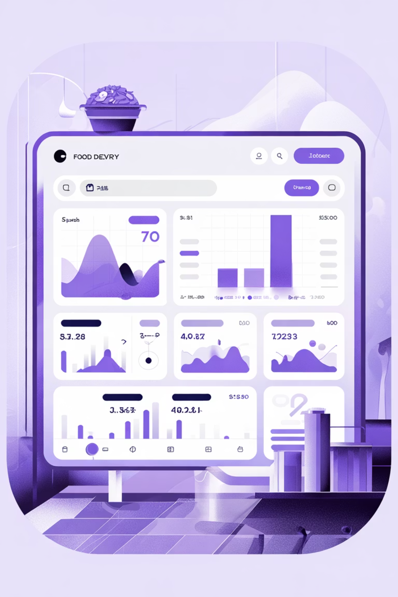
Food Delivery Analytics: SQL Case Study
A comprehensive SQL project simulating real-world business scenarios for a food delivery company. This case study demonstrates advanced SQL proficiency through analyzing customer behavior, restaurant performance, delivery efficiency, and business growth using data-driven insights.

Slide 2
Project Mission & Objectives
Core Focus
Technical Goals
This project tackles real-world challenges faced by food delivery platforms, focusing on four critical areas: customer behavior analysis, restaurant performance metrics, delivery efficiency optimization, and overall business growth tracking.
Structure relational databases with proper schema design
Clean and prepare datasets for analysis
Solve complex business problems through analytical SQL
Derive actionable insights for decision-making

Slide 3
Project Architecture
01
02
03
Database Setup
Data Import
Data Cleaning & Validation
Designed relational schema and created tables for customers, restaurants, orders, deliveries, and riders
Populated tables using CSV files representing different aspects of the food delivery system
Checked for missing values, ensured referential integrity, verified data types, and updated incomplete fields
04
05
Exploratory Analysis
Business Analysis
Conducted descriptive exploration to understand order volume, demographics, and performance metrics
Addressed 20 real-world questions using advanced SQL techniques like window functions and ranking

Slide 4

Technology Stack
PostgreSQL
pgAdmin 4
Primary database management system for SQL analytics and query execution
Query execution interface and data visualization platform
Excel
GitHub
Initial data preparation and cleaning workflows
Version control and comprehensive project documentation

Slide 5

Database Schema & Relationships
Five Core Tables
Customers: Stores customer details including ID, name, and registration date
Restaurants: Contains restaurant name, city, rating, and location data
Orders: Tracks order details including items, timestamps, and total amounts
Deliveries: Records delivery status, delivery time, and associated rider
Riders: Stores information about delivery personnel

Slide 6

Data Quality & Validation
Data Verification
Imported datasets and validated record counts, ensuring all data types matched schema requirements
Handling Missing Values
Identified and corrected null entries while ensuring referential integrity across all tables
Quality Checks
Validated delivery status, numeric field accuracy, and timestamp consistency throughout the dataset
Initial Observations
Discovered top-performing cities, daily order trends, and key delivery performance metrics

Slide 7
Key Business Questions Analyzed
This project addresses 20 real-world business questions across operations, customer behavior, and growth. Here are the critical analyses performed:
Customer Analytics
Restaurant Performance
Top 5 most ordered dishes by customer
Revenue ranking by restaurant
High-frequency customer AOV
Most popular dish by city
High-value customers (>175K spending)
Restaurant growth ratios
Customer churn analysis
Peak days for each restaurant
Customer Lifetime Value (CLV)
City revenue ranking
Operations & Delivery
Business Trends
Peak time slots (2-hour intervals)
Cancellation rate comparison
Failed delivery analysis
Customer segmentation (Gold/Silver)
Rider delivery time averages
Monthly sales trends
Rider efficiency evaluation
Seasonal order patterns
Rider ratings by delivery time
Rider monthly earnings

Slide 8
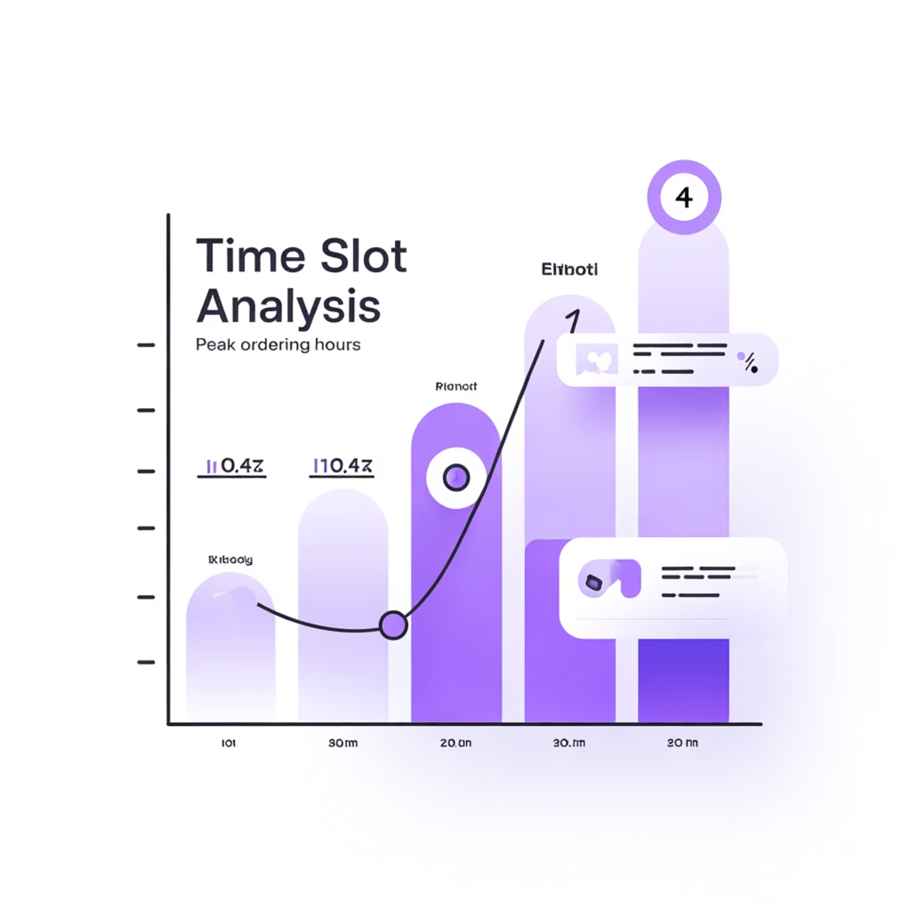

Sample Analysis: Customer Insights
Top Ordered Dishes
Peak Time Analysis
Query identifies the top 5 most frequently ordered dishes by customer "Arjun Mehta" in the last year, revealing customer preferences and ordering patterns.
Identifies time slots with highest order volume based on 2-hour intervals, enabling optimal staffing and resource allocation decisions.
High-Value Customers
Customer Segmentation
Lists customers who spent more than 175K total on food orders, identifying VIP customers for retention campaigns and personalized marketing.
Segments customers into 'Gold' or 'Silver' groups based on total spending compared to average order value, enabling targeted marketing strategies.

Slide 9




Key Insights & Business Impact
Customer Insights
Restaurant Performance
Identified top customers and most-ordered items. Segmented customers into Gold and Silver tiers. Computed CLV for retention campaigns.
Ranked restaurants by revenue and growth. Identified popular dishes and seasonal preferences. Measured month-over-month growth ratios.
Business Trends
Delivery Operations
Observed monthly revenue growth patterns. Tracked cancellation and churn rates over time. Identified seasonal demand spikes.
Analyzed peak order hours and busiest weekdays. Measured rider efficiency and delivery performance. Estimated earnings and classified riders by speed.

Slide 10

Skills Demonstrated & Contact
Technical Expertise
Connect With Me
SQL query design and optimization
Mukesh Gopi Nandh
Analytical problem-solving using CTEs and window functions
📧 mukeshudatha7@gmail.com
EDA, data validation, and transformation
🔗 LinkedIn Profile
Data storytelling and KPI extraction
Real-world business reasoning through data insights
📂 GitHub Repository

